Slide 1
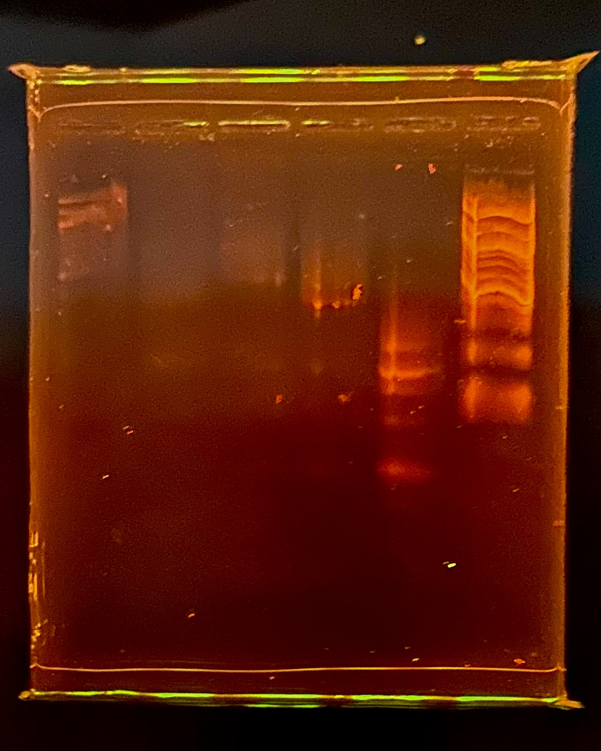
1:5 Ladder
Undiluted Ladder
1
2
3
96

